Slide 1


Claims
PARTNER.CO
2024

Slide 2

A claim includes any message or representation that Brand Partners use
to promote a product or
an opportunity, and can be presented as text, picture, graphic or symbol. Claims can be expressed or implied.

Slide 3



Regarding Income Claims, Remember:
Present your business in a proper way
Be truthful, do not deceive or mislead
Do not offer or imply any guaranteed success
Make it clear that success comes from hard work and dedication
Use specific income claims (e.g., specify how long it took you to earn what you earn today). The more specific you are, the better
Your income is based mainly on the sale of products to
end consumers
Use the Partner.Co Income Disclosure when making any claims

Slide 4


The Partner.Co Income Disclosure
Use this disclosure when making any income claims.
Partner.Co does not guarantee any level of income or success to any Brand Partner. Earnings from the Partner.Co Compensation Plan depend on each Brand Partner’s sales, business skills, ability and personal application.
(Also include a link to the Partner.Co income disclosure statement.)

Slide 5


Words to Avoid
When making income claims,
do not use the following words/phrases.
Easy
Free
Simple
Millionaire/Billionaire
Lucrative
Investment
Six/Seven-figure Income
Get Rich
Unlimited Income
Financial Freedom
Recurring Income
Replacement Income
Get Rich Quick
Passive Income
Full-time Income
Note: This list is non-exclusive.

Slide 6

Say This
Protect Your Business by Staying Compliant
Say This
Would you like to learn how to earn additional
income working from home?
Through my efforts with the company and network marketing, I can afford a better standard
of living. I work with passion, dedicating more time
to my family and friends.
I’m making extra income to support my family! Ask me how!
Thanks to this opportunity I work where I want and
earn an additional income. My life has changed!
I reached the Officer title — so exciting — ask me how!
Let me show you how you can generate a recurring, supplemental income through our Compensation Plan.
I reached 5000 LCs! I’m looking forward to redeeming them to reward myself!
Ensure you always include the Partner.Co Income Disclosure.

Slide 7
Not That
Protect Your Business by Staying Compliant
Would you like to earn an extra $1,000 this month?
Would you like to replace your full-time income working from home?
I can earn money with just a click on my phone, comfortably from my sofa.
Look at this amazing commission I just got.
Check out how fat my bank account now is.
Because of Partner.Co, I’m living the sweet life in this amazing house!
Ensure you always include the Partner.Co Income Disclosure.

Slide 8
More Examples of What to Say
Don’t Say This | Say This Instead
You can make a 6- or even 7-figure income by using our “proven system” at Partner.Co. | Most people join Partner.Co to buy our Scientific Advisory Board-endorsed products for personal use. But, if you’re interested and you work hard, you can earn meaningful supplemental income by introducing others to the products and building your business. To see what you can accomplish, visit [Income Disclosure Statement Link].
Starting at Partner.Co has allowed me to quit the 9-to-5 grind and achieve the financial freedom I’ve always wanted. | By telling my story and describing my experience with Partner.Co products and referring customers, I was able to make meaningful supplemental income that really helped my family and has even lightened our financial burdens. Most people only buy Partner.Co products for personal use, but if you’re interested and you work hard, you can earn supplemental income by introducing customers to the products and building your business. To see what you can accomplish, visit [Income Report Link].
I made $7,500 last month and only worked a couple hours a week. If you’d like to know how you can achieve this and more, message me. | Everyone could benefit from a little extra money. I can show you how you can earn meaningful commissions in your spare time by referring customers to a company that is on a mission to help everyone live happier, healthier lives. Most people will only buy these incredible products for personal, but if you’re willing to work hard, you can earn meaningful supplemental income. To see what you can accomplish, visit [Income Disclosure Statement Link].
Are you ready to have unlimited earning potential and a recurring income for life? Message me if you’re interested. | I found a company that has helped me to achieve better health and earn a little supplemental income by building a business. Message me if you’d like to try these incredible products. If you like them, I can tell you how you can earn commissions by selling to new potential customers. Most people only buy Partner.Co products for personal use, but with hard work and skill, you can earn supplemental income. To see what you can accomplish, visit [Income Disclosure Statement Link].

Slide 9
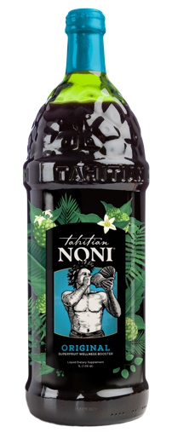
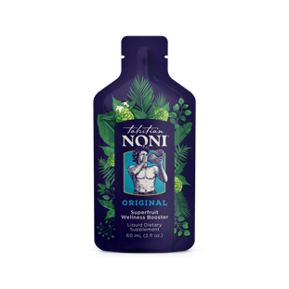
Tahitian
Noni®
ORIGINAL
Say This
Promotes overall health and wellness
Helps boost immunity defense
Helps boost energy and endurance
Supports recovery time in athletes
Helps sustain joint health and
promote mobility
Supports a healthy cardiovascular system
Helps fight harmful free radicals and protect against oxidative damage
Powerful adaptogens support a balanced stress response
Supports mood balancing effects
Contains the powerful benefits of adaptogens, antioxidants, phytonutrients and iridoids to naturally boost the immune system
Backed by clinical studies and decades
of research
Unmatched research to support your wellness journey
No artificial colors or flavors
No added sugar, gluten free, vegan, kosher and halal
Contains blueberry, which provides a high concentration of powerful antioxidants
Contains noni fruit sourced exclusively from French Polynesia, including Tahiti, which is known to have high iridoid content, contributing to its potency
Contains iridoids, which studies have shown to possess antioxidant, immune-boosting and cellular-protective benefits.
Includes grape, a superfruit with heart-healthy, anti-aging phytonutrients, including resveratrol
Produced using noni fruit from family-run farms grown without chemical fertilizers or pesticides
Undergoes rigorous quality control with each batch tested for purity, potency and iridoid content

Slide 10
Tahitian
Noni®
ORIGINAL
Don’t Say This
Helps bloating
TNJ cures asthma, anemia, diabetes, allergies, sore throat, burns, eye problems, menopause, hormonal imbalances or any other specific health diagnosis
Normalizes blood pressure
Drinking TNJ leads to
50% fewer health concerns
Boosts heart health
Helps with high cholesterol
Reduces hot flashes
Clears skin
Relieves or alleviates pain
Reduces inflammation
Supports weight loss
Supports prostate health
Supports thyroid help
“Stop taking your medications and drink this juice.”

Slide 11
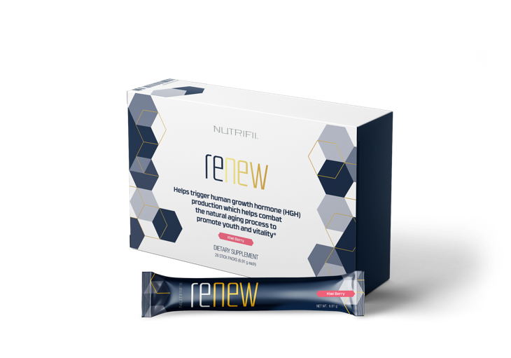
Nutrifii™
Renew
Say This
Helps trigger your body’s natural ability to produce HGH. HGH has been shown to help:
  Promote deeper,
  more restorative sleep
  Increase libido, stamina and pleasure
  Reduce body fat and increase
  lean muscle
  Promote youthful-looking skin and hair
  Improve mood and energy
  Improve cell regeneration
Formulated with ideal combination of minerals, vitamins, amino acids, Tahitian noni and other botanical extracts to aid the natural production and release of HGH in your body
Nutritional support for natural HGH production and cellular health and viability
The only supplement on the market addressing the various specific pathways of HGH decline
Not That
Eliminates visceral fat
Reduces inflammation
Alleviates pain
Any reference to any specific health diagnosis or outcomes
Any reference to improvements of any specific condition of the reproductive system
Any comparison to drugs or steroids

Slide 12
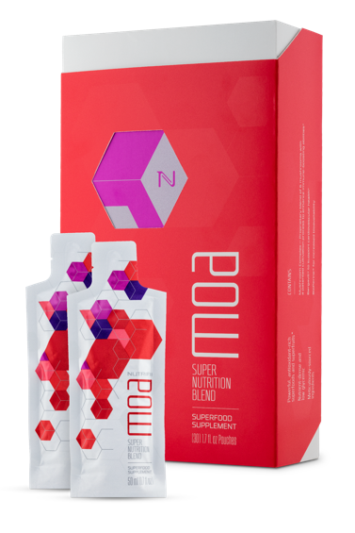
Nutrifii
Moa™
Say This
Helps fight oxidative damage
Boost metabolism & nutrient absorption
Supports healthy immune function, healthy joints, gut health
Helps increase energy
Boosted with 36 powerful superfoods and superfruits
Antioxidant-rich, nutrient-dense and low-glycemic ingredients
Patented cultivation process enhances immune-boosting abilities
Contains Bergavit® to support cardiovascular health
Contains BioPerine® for increased bioavailability
Low glycemic
Gluten free and halal
No artificial colors or flavors
Convenient, on-the-go packaging makes it easier to maintain a healthy lifestyle
Not That
Supports heart health
Supports neuropathy
Supports arthritis (and the entire spectrum of specific health conditions)
Alleviates chronic pain
Reduces inflammation
Controls diabetes
Any direct comparison to other supplements

Slide 13
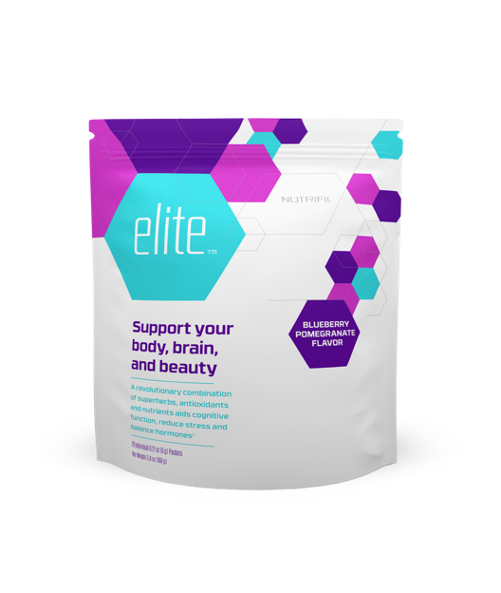

Nutrifii
Elite™
Say This
Helps elevate cognitive function and
mental performance
Promotes emotional wellness
Optimizes your mind
Boosts your mood
Enhances your ability to cope with stress
Helps balance hormones
Boosts immunity
Helps optimize your focus and fights
mental fatigue
Promotes youthful skin
Low-glycemic and gluten free
Not That
Alleviates pain
Reduces inflammation
Controls diabetes
Reference to any medical diagnosis
Any reference to weight loss drugs

Slide 14
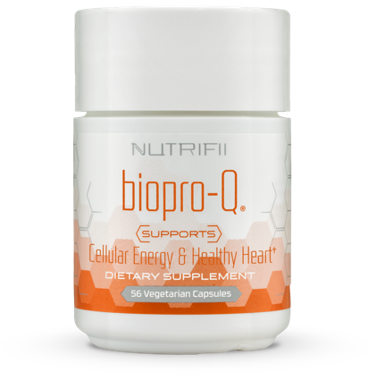
Nutrifii™
Biopro-Q®
Say This
Helps protect cells from oxidative stress
Supports cellular and
cardiovascular functions
Boosts youthful cellular energy production
Made with natural ingredients and Ubiquinol
May enhance functionality of vital cells that support the immune system
Not That
Reference to any specific
medical diagnosis
Controls cholesterol
Helps to strengthen heart and vessels
Normalizes blood pressure

Slide 15
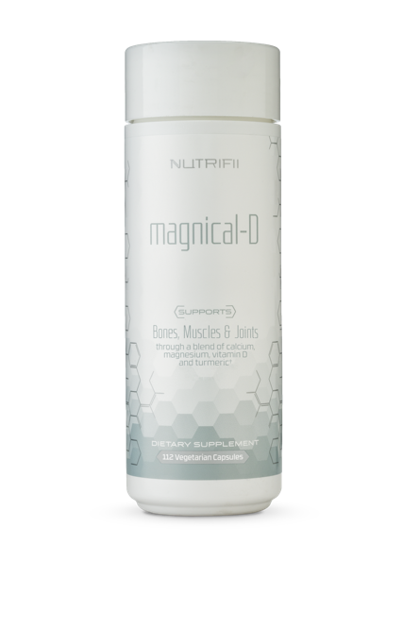
Nutrifii™
Magnical-D®
Say This
Supports healthy bones and muscles
Ensures maximum calcium absorption
in the body
Natural ingredients
Not That
Prevents muscle inflammation
Prevents osteoporosis
Reduces inflammation

Slide 16
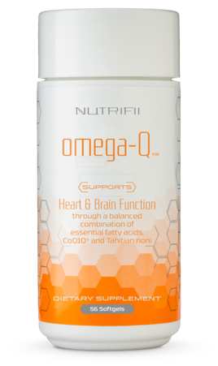
Nutrifii™
Omega-Q®
Say This
Supports the cardiovascular system
Supports optimal brain health
Helps balance healthy cholesterol levels already within the normal range
Assists in energy production
Natural ingredients
Not That
Prevents heart disease
Normalizes high blood pressure
Prevents any cognitive disease or mental disorder including, but not limited to, Alzheimer's, dementia, depression or ADHD
Reduces inflammation

Slide 17
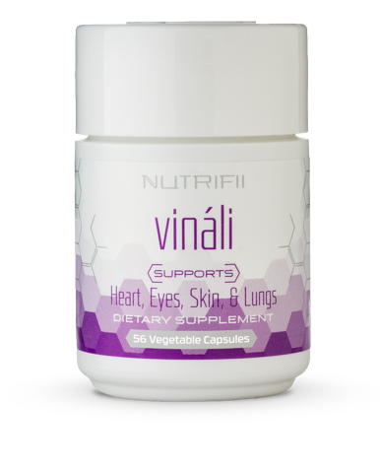
Nutrifii™
Vináli®
Say This
Expertly formulated to provide oxidative-stress protection, which helps:
  Fight premature aging
  Support the immune system
  Support heart and cardiovascular health
  Support major systems, cells
  and organs
Promotes cell health
Promotes skin elasticity
Provides free radical protection
Potent form of vitamin C which is crucial for the formation and maintenance of collagen, healthy bones and teeth
Contains citrus bioflavonoids which prevent the destruction of vitamin C to help increase its effectiveness
Has been shown to promote youthful skin and support whole-body wellness
Vegan, gluten free and halal
Not That
Anti-cellulite
Reduces fatigue
Supports constipation
Heals heart problems
Reduces or alleviates headaches
Helps with poor concentration
Helps with excess fluids

Slide 18
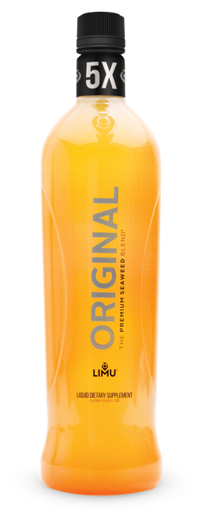
LIMU
ORIGINAL®
Say This
Supports your immune system
Supports joint mobility
Helps scavenge free radicals
Increased energy
Promotes cellular health
Rejuvenates your skin
Greater sense of health and wellness
Helps support reduction of oxidative stress
No artificial colors, flavors or sweeteners
No added sugar
Gluten free, vegan, kosher and halal
Not That
Provides allergy relief
Protects against disease
Reduces inflammation
Reduces stroke damage
Lowers cholesterol
Reference to any specific
medical diagnosis

Slide 19
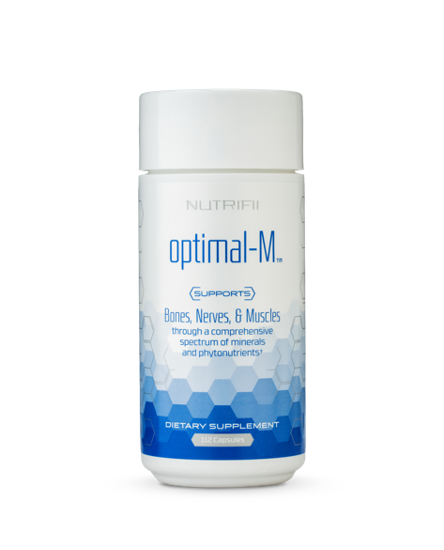
Nutrifii™
Optimal-M®
Say This
Supports bone, nerve and muscle health while contributing to optimal
cellular function
Broad spectrum of vital minerals,
trace elements, enzymes and
superfood micronutrients
Properly balanced ratios for daily use and superior absorption
Optimum daily allowance is used for meeting optimal nutrition, rather than the bare minimum
Natural ingredients
Gluten free and halal
Veggie capsules
Not That
Supports arthritis, polyarthritis, Fibromyalgia and/or joint pain
Reduces cellulite
Reduces muscle pain
Helps with health problems
Supports asthma
Supports depression
Any reference to a specific
medical condition

Slide 20
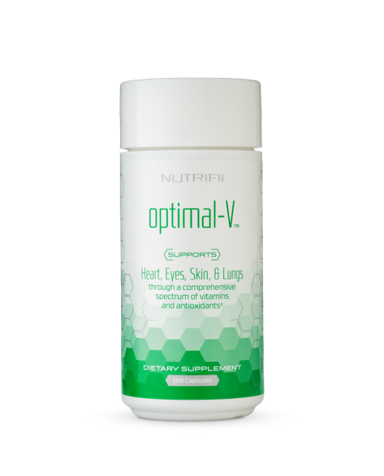
Nutrifii™
Optimal-V®
Say This
Supports heart, eyes, skin and
lung health
Comprehensive spectrum of high-potency vitamins, antioxidants, phytonutrients and micronutrients
Helps to correct nutrient deficiencies and support critical cellular function in the body
Properly balanced ratios for daily use and superior absorption
Optimum daily allowance is used for meeting peak nutrition, rather than the bare minimum
Gluten free and halal
Natural ingredients
Not That
Supports arthritis, polyarthritis, Fibromyalgia and/or joint pain
Reduces cellulite
Reduces muscle pain
Helps with health problems
Supports asthma
Supports depression
Any reference to a specific
medical condition

Slide 21
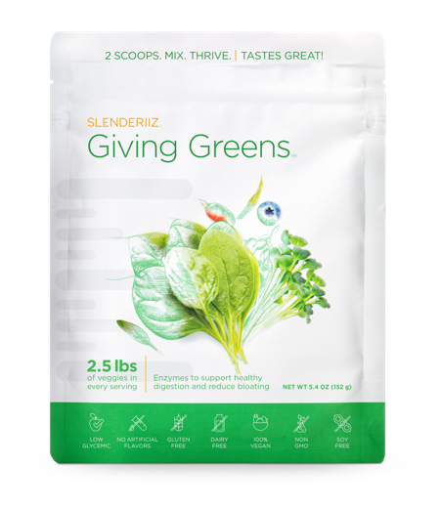
Slenderiiz
Giving Greens®
Say This
Optimizes the digestive process
Supports weight management
Supports healthy immune function
Supports cardiovascular health
Helps fight damage caused by free radicals
Improves nutrient absorption
Helps manage bloating
Not That
Offers weight loss benefits
Anti-inflammatory
Controls diabetes
Supports heart health
Any reference to a medical condition

Slide 22
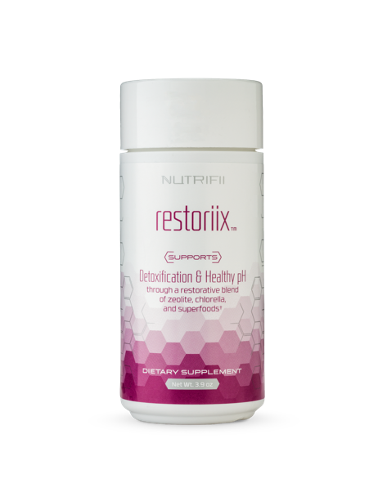
Nutrifii
Restoriix™
Say This
Attracts and removes heavy metals
Assists your body in the safe removal of toxins
Helps restore pH levels
Natural ingredients
Not That
Skin-smoothing
Fights acne
Supports cell regeneration
Cleanses liver, blood and lymph nodes
Restores body processes
Detoxes cells
Whitens teeth

Slide 23
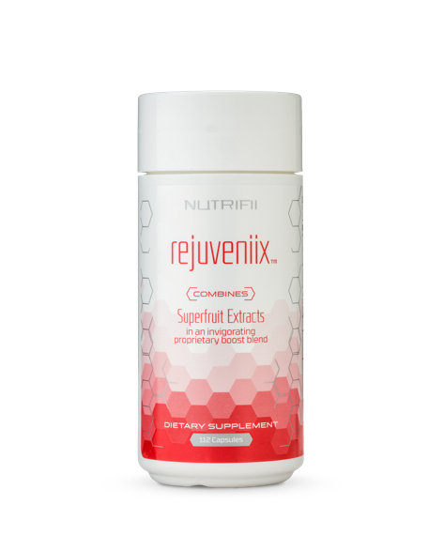
Nutrifii
Rejuveniix™
Say This
Boosts energy
Enhances mental alertness
Sharpens focus
Elevates mood
Supports weight loss performance
Natural ingredients
Not That
Any reference to supporting mental disorders including, but not limited to, ADHD or depression
References to any cognitive disease
Any reference to “jelly belly”
Anti-cellulite

Slide 24
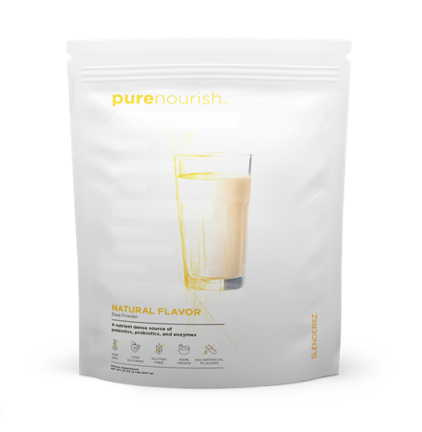
Slenderiiz®
PureNourish™
Say This
Supports healthy digestion
Supports optimal memory function
Aids cardiovascular and
liver wellness
Contains plant-derived amino acids
Good source of DHA – Omega-3’s
Probiotic, prebiotic and enzyme blend
Nutrient dense without the calories
Non-GMO, low glycemic, vegan and gluten free
Dairy, soy and wheat free
Sweetened with Stevia
Healthy source of protein
No artificial flavors
No preservatives
Not That
Removes belly fat
Boosts metabolism
Controls appetite
Any reference to any medical condition

Slide 25
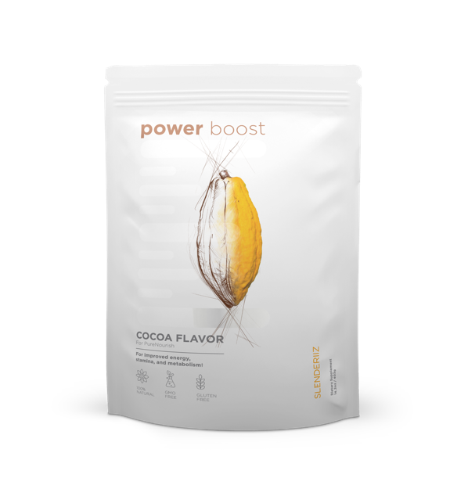
Slenderiiz®
Power Boost™
Say This
Supports lean muscle mass
Promotes weight management
Provides post-workout nutrients
Enriched with pure cocoa
for antioxidants and
cardiovascular support
Medium-chain triglycerides from
all-natural coconut oil
enhance endurance
L-glutamine supports optimal athletic performance and recovery
Branch-chain amino acids (BCAAs) decrease mental fatigue and preserve lean muscle mass
Non-GMO, low glycemic, vegan and gluten free
Dairy, soy and wheat free
Sweetened with Stevia
No artificial flavors or preservatives
Not That
Provides muscle pain relief
Prevents any cognitive disorder
or disease
Boosts metabolism
Prevents complications in liver disease
Any reference to a specific medical condition or diagnosis

Slide 26
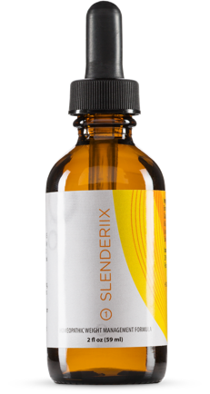
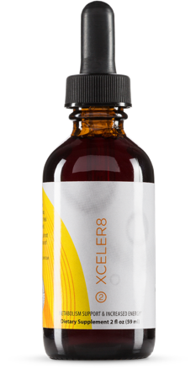
Slenderiiz®
Slenderiix™
& Xceler8™ Drops
Say This
Lose weight 2x faster than diet and exercise alone*
“I lost XX lb. in 28 days! Results not typical, individual results vary.”
Helps curb hunger & control appetite
Helps balance hormones, including insulin, leptin, ghrelin & cortisol
Use as part of your diet to maintain healthy blood sugar levels
Increases energy
Helps you stay motivated
Helps with stress and stabilizing your mood so you don’t overeat
Helps stimulate metabolism
Homeopathic, gluten-free, natural & hormone-free
Not That
Any reference to weight loss drugs (e.g., Ozempic, Wegovy, etc.)
Reference weight loss # without a disclaimer
Reduces inflammation
Balances women’s cycles/hormones
Manages pain
Detoxes liver
Provides clear skin
Balances thyroid (implication of outcome)
Controls insulin resistance
Improves immune system (implication of outcome)
Improves pH levels
*In a study, subjects using Slenderiiz® products lost more than twice as much weight as subjects who did not use Slenderiiz products. All participants limited daily food intake to 1,250 calories. These statements have not been evaluated by the FDA. This product is not intended to diagnose, treat, cure or prevent any disease.

Slide 27

For questions, contact compliance@partner.co.
You will receive an email from compliance@fw.partner.co
if your post does not meet our compliance guidelines.

Slide 28


PARTNER.CO
2024

